Slide 1
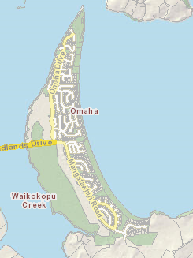
Pest Free Omaha A community collaboration

Slide 2
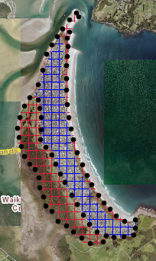
Controlling predators
Staging and layout for the top two
– mustelids, possums and rats:
Traps preferred to bait stations to avoid conflicts with domestic pets, reduce use of toxins
Stage 1 Black dots, DoC 200 trap line
Stage 2 Red cross hatch, Traps, Natural area
Stage 3 Blue cross hatch, Traps, Residential area
A plan is also being worked on for rabbits & hedgehogs

Slide 3
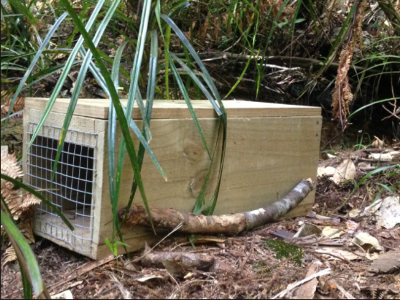
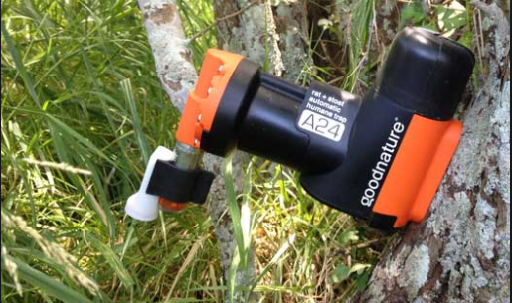
Traps
DOC 200
a kill trap for rats & mustelids,
needs to be elevated where ground nesting birds (e.g. fernbird) are present to prevent bycatch
Good Nature A24
self resetting trap for rats &mustelids,
a good solution where people may not be permanent residents or don’t want to handle a trap and/or dead animals, safe around domestic pets & children

Slide 4
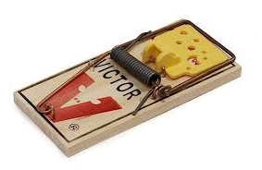
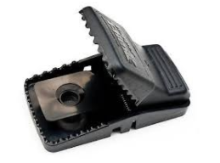
Traps for rats
Victor Professional
- a kill trap
- easy to set & cost effective,
- Must be set in a tunnel/box to avoid bycatch
T- Rex
- quick & easy to set, heavy duty plastic
- good in exposed coastal environments
- Must be set in a tunnel/box to avoid bycatch

Slide 5
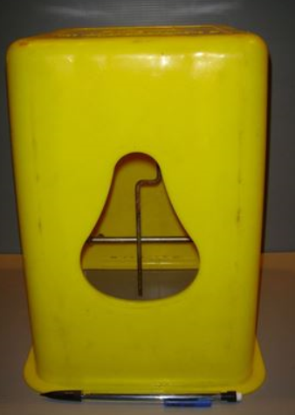
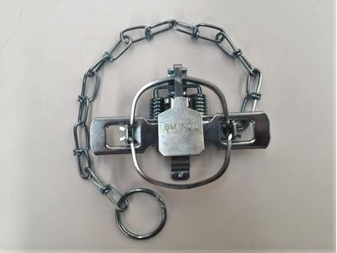
Traps for possums
A range of traps are available
Possums are generally not present in big numbers other than in Taniko Reserve
The most effective way of managing them at Omaha is with a professional trapper
This would enable a cost effective control programme to be put in place

Slide 6
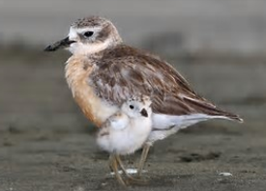
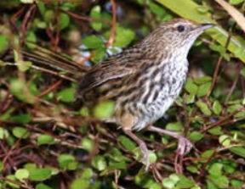
How many do you need?
The Omaha Peninsula is 619ha
Rats: 2 traps/ha = 1238
Mustelids: 1 trap/6 hectares = 104 traps
When is the best time to trap?
ideally all year round but can also trap seasonally.
Prior to breeding season (land birds - before spring, shore birds – before summer).

Slide 7
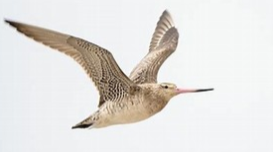
Who would do it?
The community would lead - ideally with a co-ordinator
A combination of volunteers & experienced contractors is usually the best combination
People are often supportive of an initiative, they may pay for some traps, be happy for them to be on their land but are busy – contractors can efficiently install & manage networks & reduce work for volunteers who are often stretched.

Slide 8
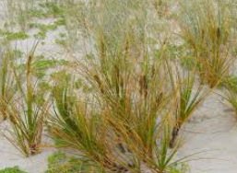
How could it be funded?
Community/landowner contributions (buy traps, contribute volunteer time)
Auckland Council – provide some traps, technical advice
Sponsorship and environmental funds (e.g. Lotteries, Foundation North)
Sponsor a trap….. Get in Behind campaign similar to Tawharanui Pest Proof Fence… help the neighbours campaign…….

Slide 9
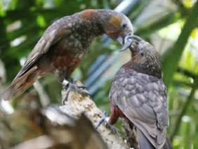
What are the benefits of pest free Omaha
- Undertaking landscape scale pest control effectively reduces pest numbers over a larger area and reduces reinvasion potential
Benefits native plants & animals particularly ground nesting birds and species like lizards etc.
Increases the potential for new species to establish, e.g. kiwi from Tawharanui, kaka, bellbirds
Gardens, fruit trees, lawns, houses free of rodents & browsing pests
Community driven projects galvanise people & encourage ownership & responsible management of issues such as wandering domestic pets

Slide 10
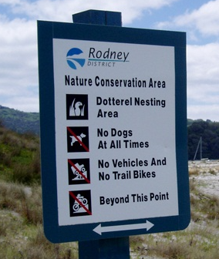
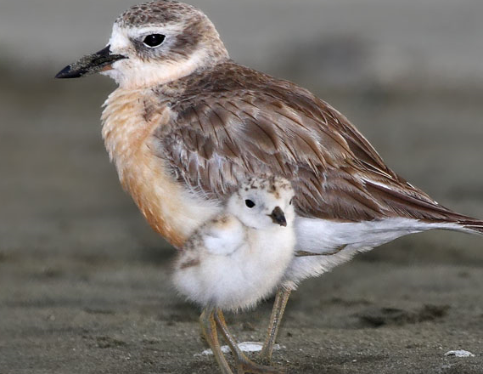
What are the benefits of pest free Omaha?
International importance of Omaha spit to Northern NZ dotterel - about 10% of the total population of NZ dotterels in the world at Omaha spit from ~ March to September, as well as a high density of ground nesting pairs that live there all year round
Important for OSPT to continue to be responsible for any trapping and predator control carried out inside the predator proof fence, because this is such a special place for the shorebirds. Some forms of traps & the use of poisons could be detrimental to their survival.

Slide 11
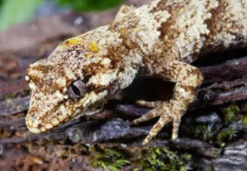
What’s next?
This is a suggested programme only and is dependant on the outcome of the community pest control workshop:
- Completed Operational Plan - mid Jan 2018
Get OBC traps out - by end of Jan 2018
Cost estimate for undertaking rabbit control - ????, evaluate need 1st
Community pest control workshop - mid January 2019
Present project to Rodney Local Board - October 2018
Obtain funding for pest free programme - January – May 2019
Commence pest free programme - Winter 2019

